Slide 1

Unit-1: Introduction to Microprocessor
Microprocessor and Interfacing
(MPI)
GTU # 3160712
Prof.Swati R Sharma
Computer Engineering Department
swati.sharma@darshan.ac.in
(O) 9727747317

Slide 2
Introduction to Microprocessor

Looping
Topics to be covered
What is a Microprocessor?
Basic concepts of Microprocessor
Comparison Microprocessor vs. Microcontroller
System Bus
Microprocessor systems with bus organization

Slide 3
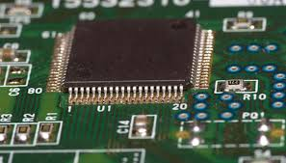
What is a Microprocessor?

Slide 4

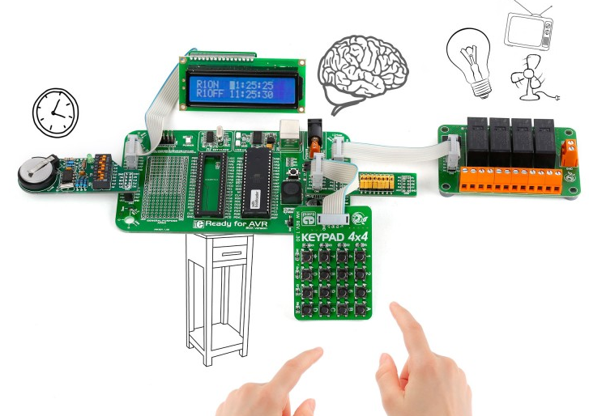

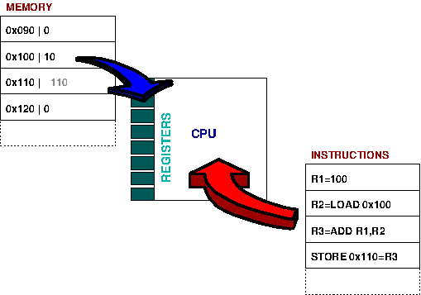
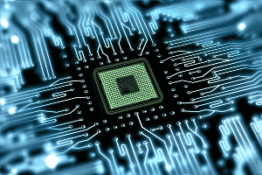
What is a Microprocessor?
Definition:
“The Microprocessor is a
Multipurpose,
Programmable,
Clock Driven,
Register Based, Digital-Integrated Circuit
which accepts binary data as input,
processes it according to instructions stored in its memory, and provides results as output.”
Can perform multiple tasks
Can be instructed to perform specific task
Provides Synchronization
Store Intermediate Processing data
Form of an Integrated circuit (IC)

Slide 5
Basic concepts of Microprocessor

Slide 6
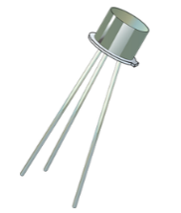
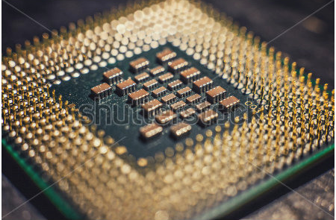
Basic concepts of Microprocessors
Microprocessor is a computer Central Processing Unit (CPU) on a single chip that contains millions of transistors connected by wires.
Processor | No. of transistors
Intel 8085 | 6500
Pentium IV | 42 million
Core i3 | 1.4 Billion
Core i7 | 1.7 Billion

Slide 7
Basic concepts of Microprocessor
Microprocessor
Silicon chip which includes ALU, Register circuits & Control circuits
Microprocessor
Registers
Control
Logic
ALU

Slide 8
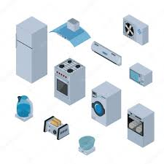
Basic concepts of Microprocessors
Silicon chip which includes microprocessor, memory & I/O in a single package.
Microcontroller
Microcontroller
Micro
Processor
RAM
ROM
I/O
Notes:
A microcontroller is a compact integrated circuit designed to govern a specific operation in an embedded system. A typical microcontroller includes a processor, memory and input/output (I/O) peripherals on a single chip.

Slide 9
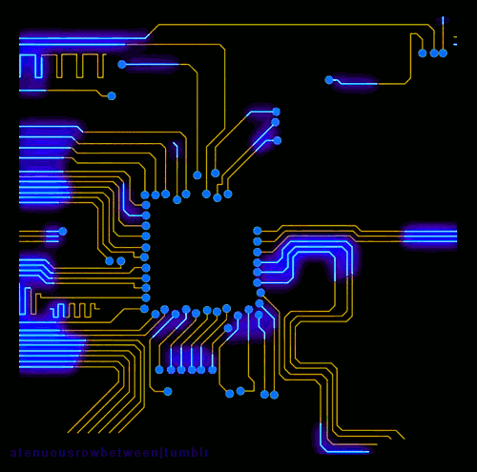
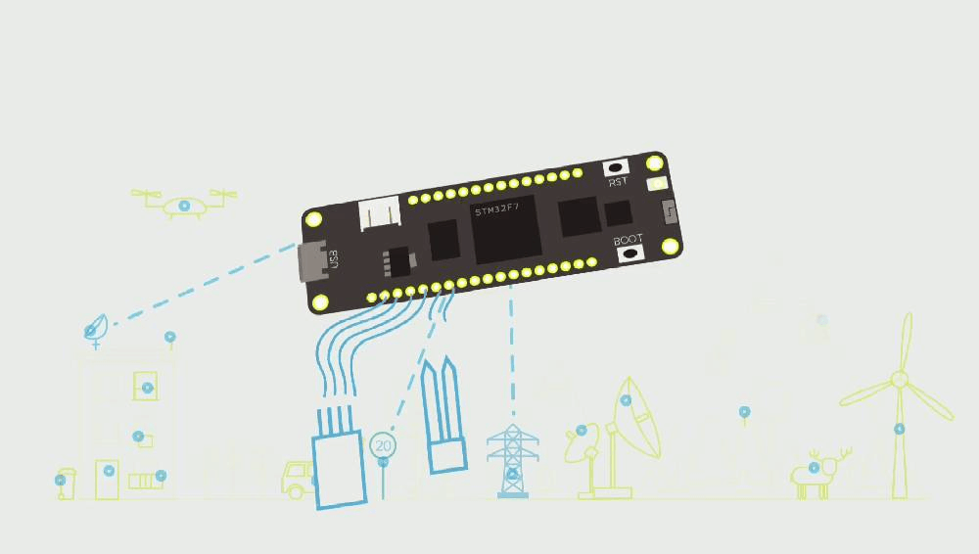
Microprocessor vs. Microcontroller

Slide 10
Microprocessor vs Microcontroller
Microprocessor | Microcontroller
It is vital part of computer system. | It is vital part of embedded system.
It contain CPU inside it but does not contain on chip RAM, ROM and other peripherals. | It has CPU, fixed size of RAM, ROM and peripherals mounted on a single chip.
It is multipurpose device which performs several tasks. E.g. Software development, word processing, playing games, surfing etc. | It is designed for specific task with fixed input, processing and output. E.g. Operating a washing machine, handling mouse click event etc.
It operates at high speed compared to microcontroller. E.g. Clock speed of latest microprocessor is measured in GHz. | It operates at comparatively lower speed than microprocessor. E.g. Clock speed is measured in MHz.
Application: Desktop PC’s, Laptops, notepads etc. | Application: Microwave oven, washing machine, remote control, Mouse etc.

Slide 11
Basic concepts of Microprocessors
Microcomputer
A small computer with a microprocessor as its CPU. Includes memory, I/O etc.
Microcomputer
Keyboard
Micro
processor
RAM
Display
ROM
I/O
Que:Explain the difference between a microprocessor and a microcomputer.[3-marks, GTU Exam Winter 2018]

Slide 12
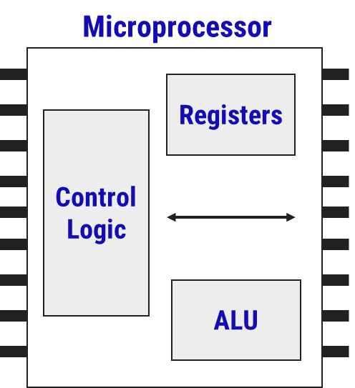
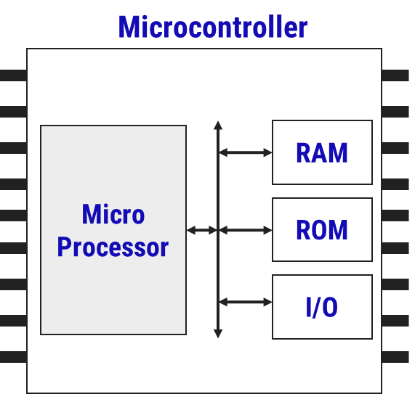
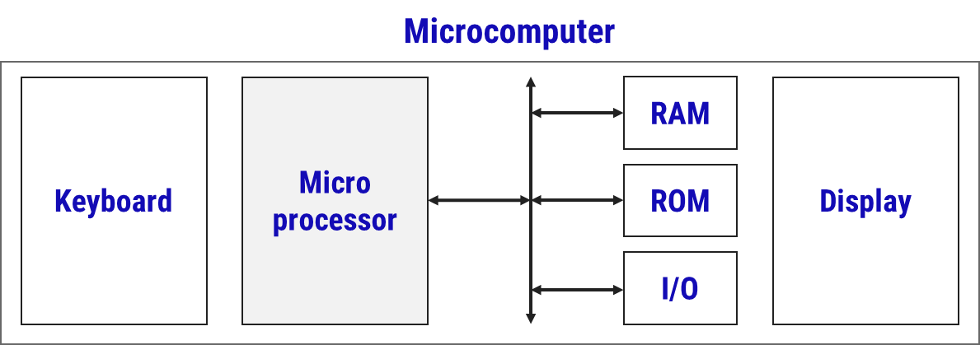
Microprocessor, Microcontroller and Microcomputer

Slide 13
Components of Microprocessor

Slide 14
Components of Microprocessor
Brain of the computer.
Performs Arithmetic and Logical operations
Small additional memory location, which are used to store and transfer data.
Arithmetic and Logical Unit (ALU)
Register Array
Control Unit
It controls and executes the flow of data between the microprocessor, memory and peripherals.
Signal permits the CPU to receive or transmit data.

Slide 15
System Bus

Slide 16
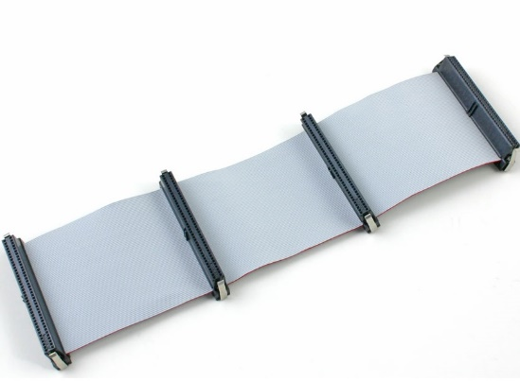
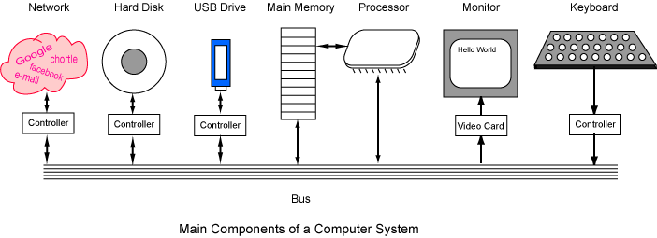
System bus
The network of wires or electronic pathways is known as 'Bus'.
The technique was developed to reduce costs and improve modularity.
Classification
Address Bus - Transfer Address
Data Bus - Transfer Data
Control Bus - Transfer Control Signal

Slide 17
System bus
CPU
Memory
Input/Output
System Bus
Control Bus
Address Bus
Data Bus

Slide 18
Address Bus
CPU
Memory
Input/Output
System Bus
Control Bus
Address Bus
Data Bus

Slide 19
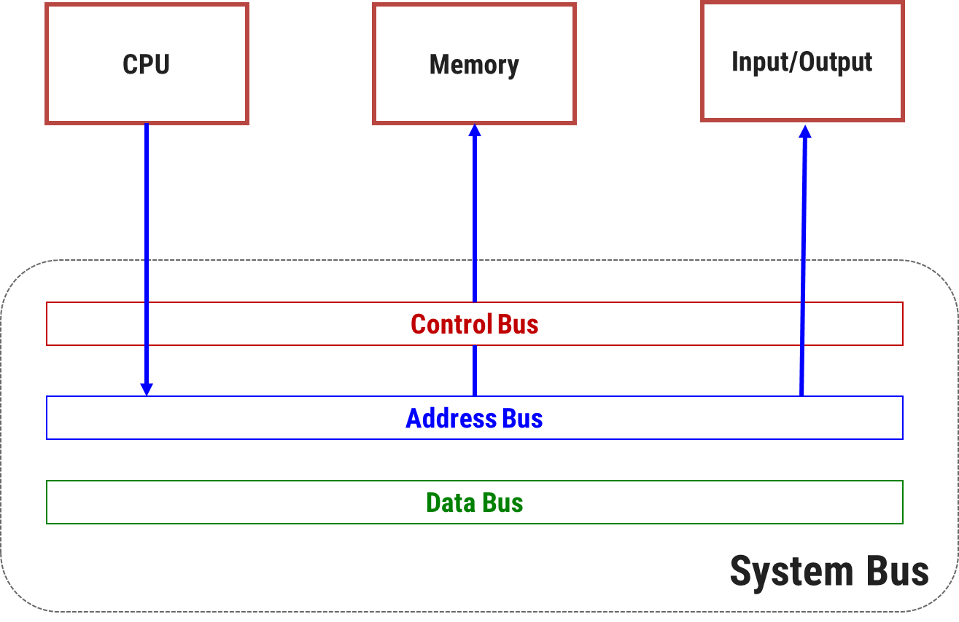
Address Bus
Transfers the addresses of Memory or I/O devices.
Address bus is unidirectional.
The maximum address capacity is equal to two to the power of the number of lines present (2^{lines}).
E.g. 8085 has 16-address lines
∴ Maximum address capacity
2¹⁶ = 65536 bytes

Slide 20
Data bus
CPU
Memory
Input/Output
System Bus
Control Bus
Address Bus
Data Bus

Slide 21
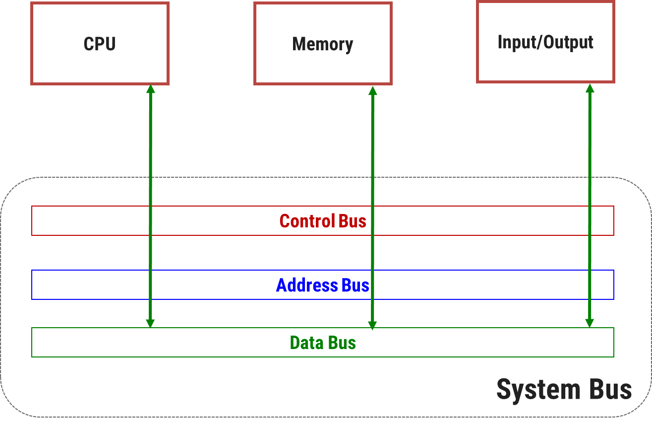
Data Bus
It is used to transfer data within Microprocessor and Memory/IO devices.
Data Bus is bidirectional as Microprocessor requires to send and receive data.
Each wire of data bus is used to transfer the data corresponding to a single bit of binary data.
E.g. 8085 has 8 - data lines
∴8085 is known as 8-bit processor

Slide 22
System bus
CPU
Memory
Input/Output
System Bus
Control Bus
Address Bus
Data Bus

Slide 23
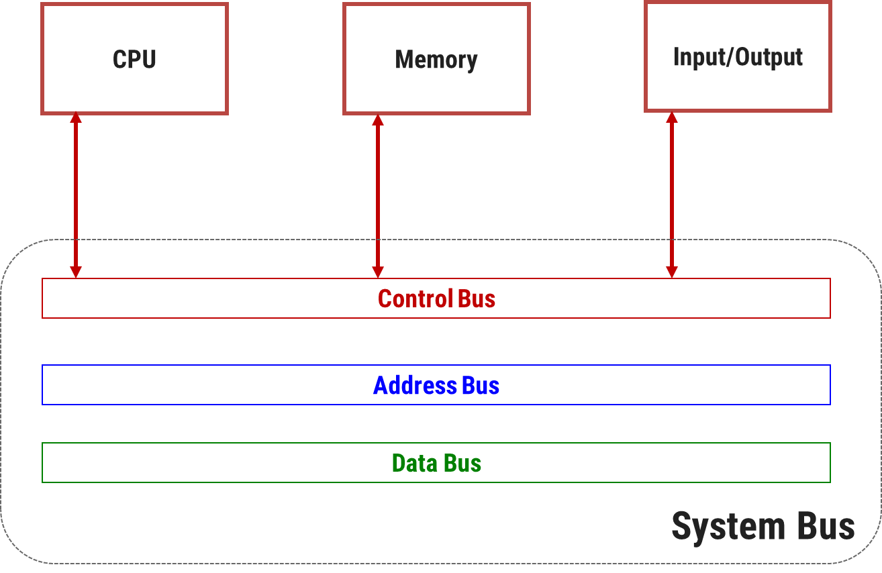
Control Bus
Microprocessor uses control bus to process data.
i.e. what to do with the selected memory location.
Some control signals are Read, Write and Opcode fetch etc.
Control Bus is bidirectional.
This is a dedicated bus, because all timing signals are generated according to control signal.

Slide 24
Microprocessor systems with bus organization

Slide 25
Microprocessor systems with bus organization
Input/Output
Arithmetic and Logical Unit (ALU)
Register Array
System Bus
Control Unit
Memory
ROM
RAM

Slide 26
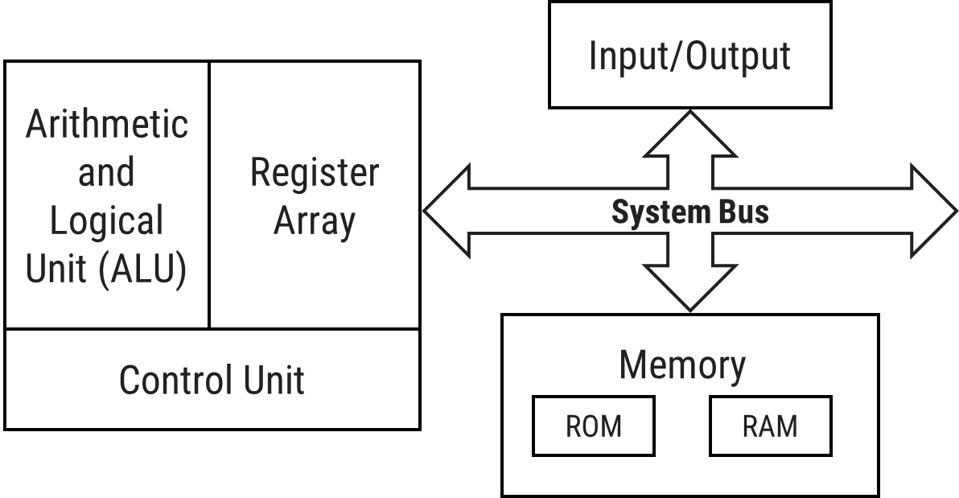
Microprocessor systems with bus organization
In most simplified form a microprocessor based system consist of a Microprocessor, I/O (Input/Output) device and Memory.
These components are interfaced (connected) with microprocessor over a common communication path called system bus.
Microprocessor is master of the system and responsible for executing the program.

Slide 27
Microprocessor systems with bus organization
Memory is responsible for storing program as well as data.
System generally consists of two types of memories:
ROM (Read only and non-volatile) and
RAM (Read/write and volatile).
I/O devices are used to communicate with the outer environment.
Example of input device: keyboard, mouse.
Example of output device: monitor, printer.

Slide 28
GTU Exam Questions
Sr | Questions | Marks | Year
1. | Explain the difference between a microprocessor and a microcomputer. | 3 | W’18
2. | How can you determines that Microprocessor is an 8, 16 or 32 bit. | 3 | W’19
3. | List and specify the various features of microprocessor, memory and I/O devices including concepts of system bus. | 7 | W’19

Slide 29

References
Book: | Microprocessor Architecture, Programming, and Applications with the 8085, Ramesh S. Gaonkar Pub: Penram International

Slide 30
Thank You

